Slide 1
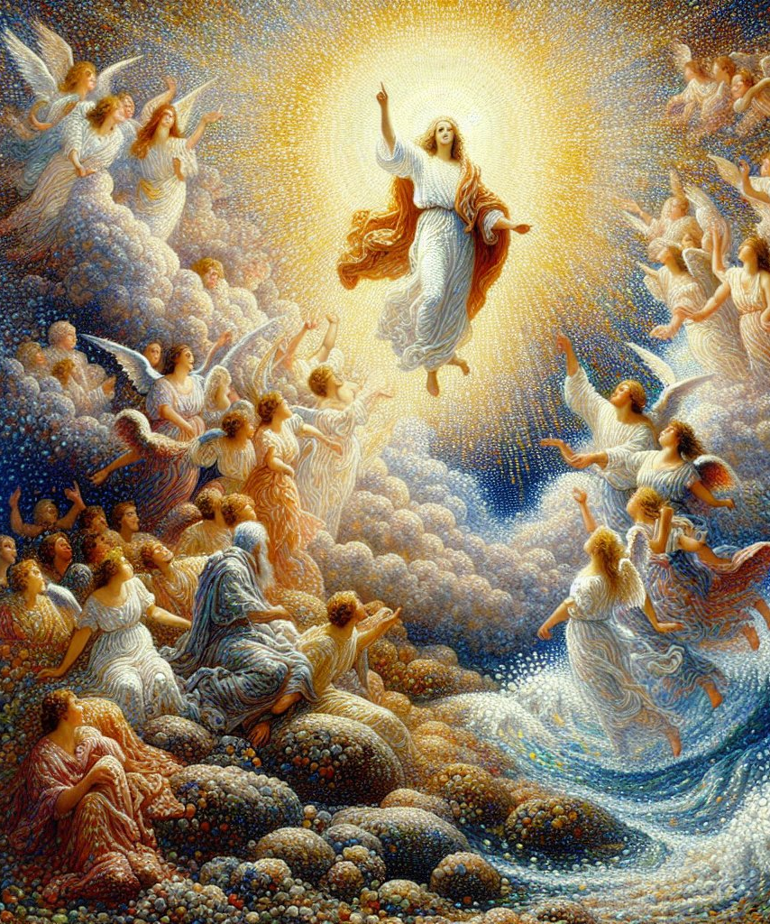
Worship before the throne Lesson Text: revelations 4:1-11
GOLDEN TEXT:
"And the four beasts had each of them six wings about him; and they were full of eyes within: and they rest not day and night, saying, Holy, holy, holy, Lord God Almighty, which was, and is, and is to come." Revelation 4:8

Slide 2
Today’s aim
Facts: To present John's vision of heaven.
Principle: To realize that the main activity of heaven is worship of the Triune God.
Application: To urge believers to enlarge their worship capacity while waiting to enter heaven.

Slide 3
SCRIPTURE LESSON TEXT
PREDICTION OF THE FUTURE
¹ After this I looked, and, behold, a door was opened in heaven: and the first voice which I heard was as it were of a trumpet talking with me; which said, Come up hither, and I will shew thee things which must be hereafter.
² And immediately I was in the spirit: and, behold, a throne was set in heaven, and one sat on the throne.
³ And he that sat was to look upon like a jasper and a sardine stone: and there was a rainbow round about the throne, in sight like unto an emerald.
⁴ And round about the throne were four and twenty seats: and upon the seats I saw four and twenty elders sitting, clothed in white raiment; and they had on their heads crowns of gold.
⁵ And out of the throne proceeded lightnings and thunderings and voices: and there were seven lamps of fire burning before the throne, which are the seven Spirits of God.

Slide 4
PRAISE GIVEN TO GOD
⁶ And before the throne there was a sea of glass like unto crystal: and in the midst of the throne, and round about the throne, were four beasts full of eyes before and behind.
⁷ And the first beast was like a lion, and the second beast like a calf, and the third beast had a face as a man, and the fourth beast was like a flying eagle.
⁸ And the four beasts had each of them six wings about him; and they were full of eyes within: and they rest not day and night, saying, Holy, holy, holy, Lord God Almighty, which was, and is, and is to come.

Slide 5
PROSTRATE BEFORE THE THRONE
⁹ And when those beasts give glory and honour and thanks to him that sat on the throne, who liveth for ever and ever,
¹⁰ The four and twenty elders fall down before him that sat on the throne, and worship him that liveth for ever and ever, and cast their crowns before the throne, saying,
¹¹ Thou art worthy, O Lord, to receive glory and honour and power: for thou hast created all things, and for thy pleasure they are and were created.

Slide 6
No matter what happens on earth, the Lord is reigning in heaven and is in control of everything (Rev. 4:1-2).
God should be at the center of our attention, just as He is the focal point of all heaven (vss. 3-4).
We should never lose sight of the majesty of our God
(vs. 5).
Worship is the occupation of the inhabitants of heaven and should be prominent in our lives here on earth (vss. 6-9).
No created being is worthy to receive the glory and praise that belong to the Creator alone (vss. 10-11).
1
PRACTICAL
POINTS
2
3
3
4
5

